Slide 1
DIGITAL PORTFOLIO
STUDENT NAME : J.THIRUCHANTHAN
REGISTER NO :2413410180121001
NM ID :8206BAD64BD7CC284084AA5257C455E2
DEPARTMENT :INFORMATION TECHNOLOGY LOGY
COLLEGE :BEST ARTS AND SCIENCE COLLEGE,SIRKALI

Slide 2
PROJECT TITLE
  Creative Student portfolio using FWD

Slide 3
AGENDA
          Problem Statement
          Project Overview
          End Users
          Tools And Technologies
          Portfolio Design And Layout
          Features And Functionality
          Results And Screenshots
          Conclusion
          Github link

Slide 4
  PROJECT OVERVIEW
Portfolio Contains About Me, Projects, Skills, Contact And Pictures

Slide 5
  PROBLEM STATEMENT
In Today Digital Era Traditional Resume Alone Are Not Enough To Showcase Skills And Projects Effectively. Many Students And Professionals Lack A Structures Online Presence To Highlight Their Work. A Digital Portfolio Provides An Interactive And Accessible Platform To Present Achievements, Skills And Experiences.

Slide 6
  WHO ARE THE END USERS?
STUDENTS(academic projects, resumes)
JOB SEEKERS(to share with recruiters)
PROFESSIONALS(to show clients)
SOFTWARE EMPLOYEE

Slide 7
  PORTFOLIO DESIGN AND LAYOUT
HTML – Pages Sections
CSS-LAYOUT – colors,font
JAVASCRIPT-interactive navigation,form validation
VS CODE – implementation code editor, github link

Slide 8
  TOOLS AND TECHNIQUES
SECTION
HOME
PROJECTS
SKILLS
CONTACT
MOBILE/DESKTOP/TABLET

Slide 9
  FEATUERS AND FUNCTIONALITY
NAVIGATION BAR WITH SMOTH SCROLLING
IMAGE DETAILS/HYPERLINKS
INTERACTIVE ELEMENTS – ANIMATIONS, HOVER EFFECTS,BACKGROUND COLOUR CHANGE
CONTACT FROM VALIDATE

Slide 10
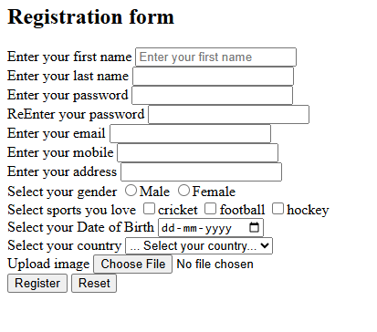
  RESULTS AND SCREENSHOT

Slide 11
  CONCLUSION
  Easy To Share With Recruiters It Makes Online Presence

Slide 12
  GITHUB LINK

